Slide 1
Weekly meeting
10 05 2023
Ty Bottorff

Slide 2
Outline
Summary of findings and limitations of T cell characteristics associated with toxicity to immune checkpoint blockade in patients with melanoma (Newman lab)
Progress in reproducing data from Newman lab paper
Next steps
Plans to explore unanalyzed data from Newman lab paper

Slide 3
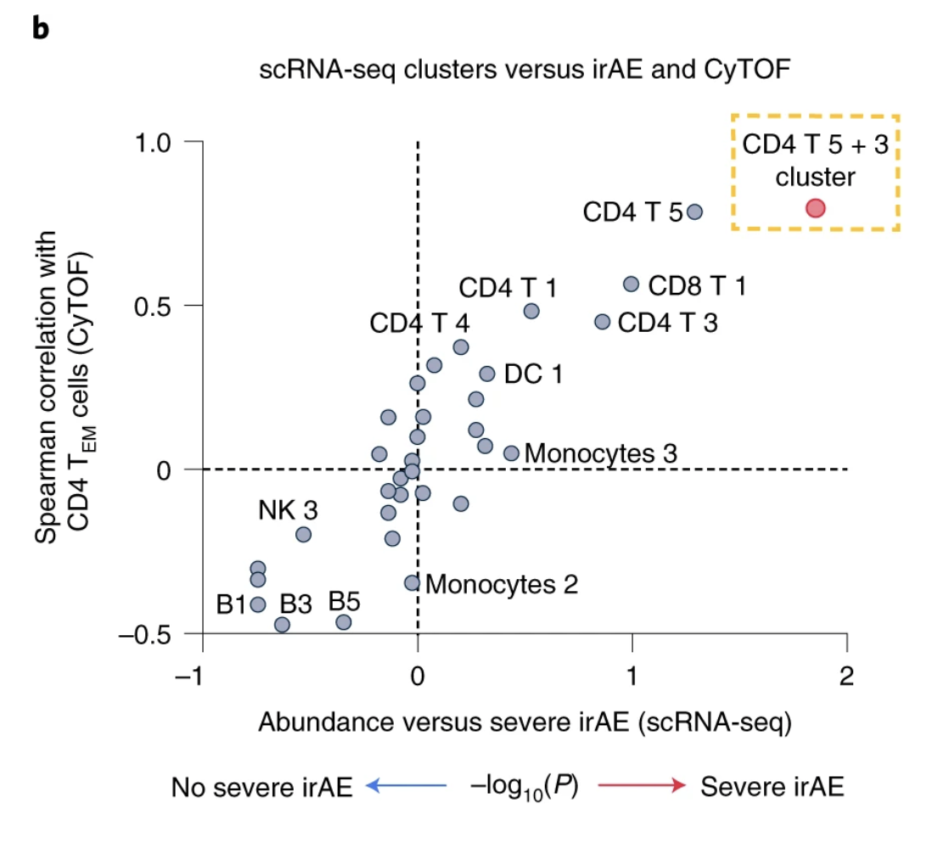
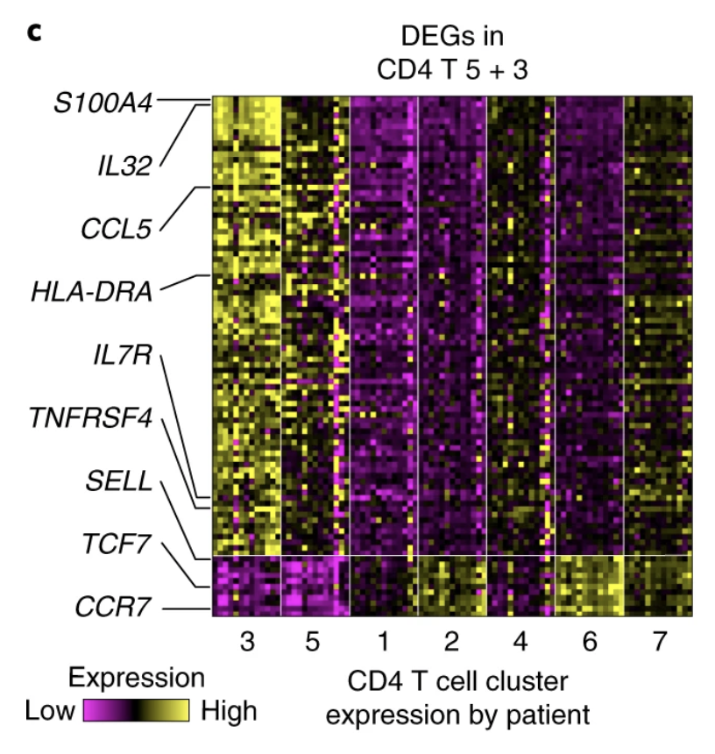
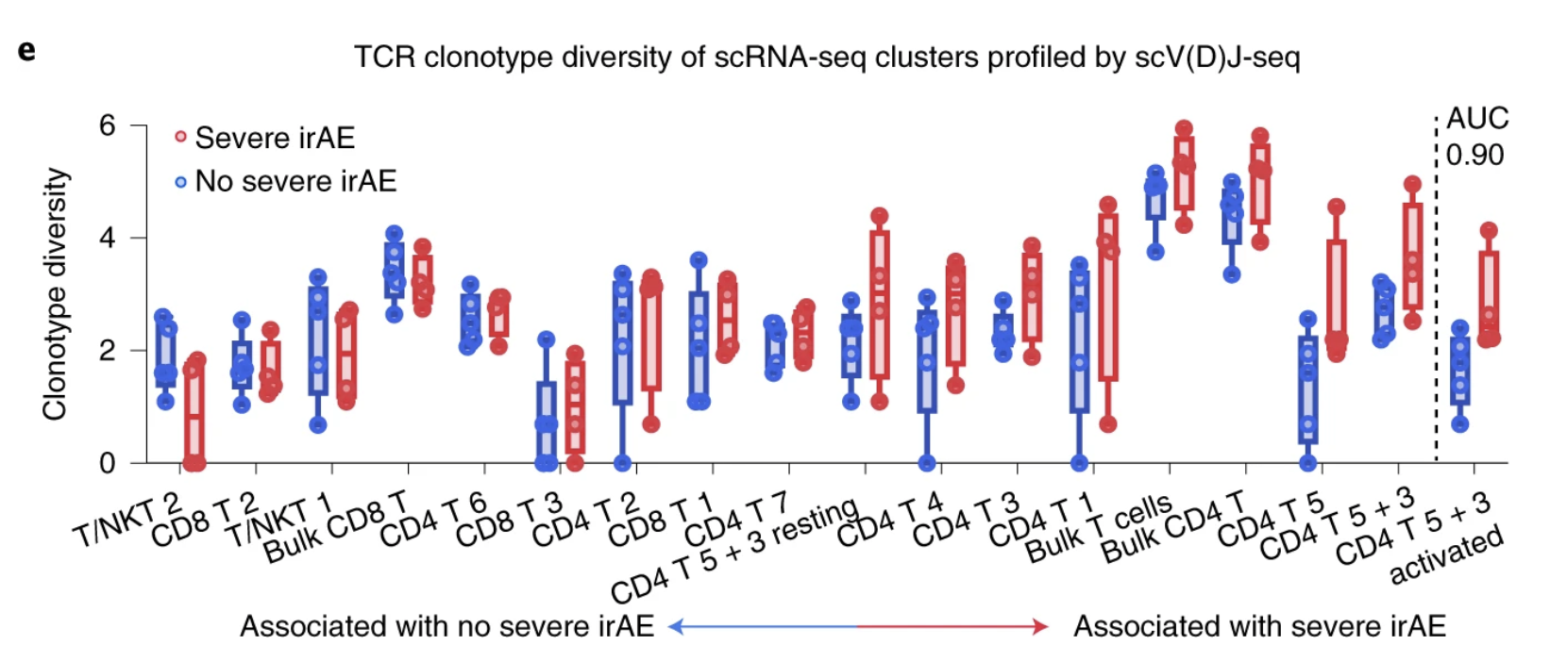
Main findings from Newman lab paper
Activated CD4 effector memory T cell abundance and TCR diversity associated with irAEs in melanoma patients
Notes:
- CD4 effector memory T cells at higher levels in pretreatment blood associated with severe irAE
- also find elevated activated CD4 TM cells in autoimmune disease patients, perhaps a common immunological mechanism between irAEs and autoimmunity
Pretreatment TCR clonotype diversity within each T cell state, total T cells, CD8 T cells, CD4 T cells and activated versus resting CD4 T 5 + 3 cells (defined as in d), grouped by future irAE status. TCR diversity was calculated for all patients with at least 100 TCR clones (n = 9; Methods). States are ordered by the AUC between TCR diversity and severe irAE status. Activation refers to CPM > 0 of HLA-DX and MKI67

Slide 4
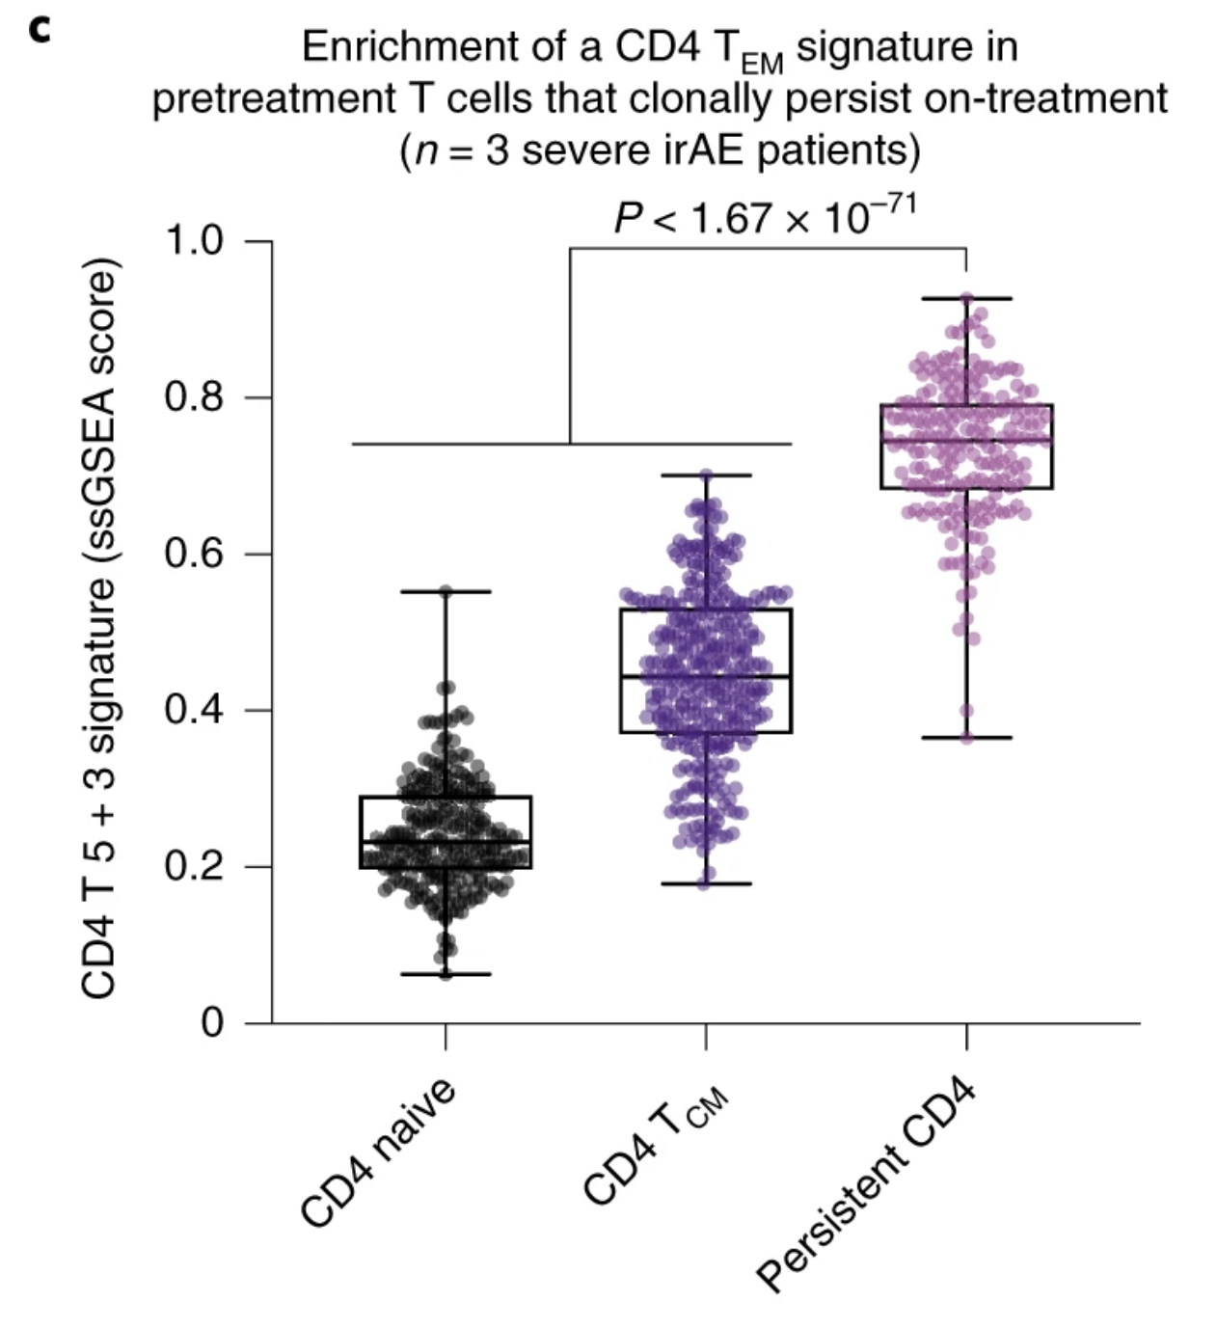
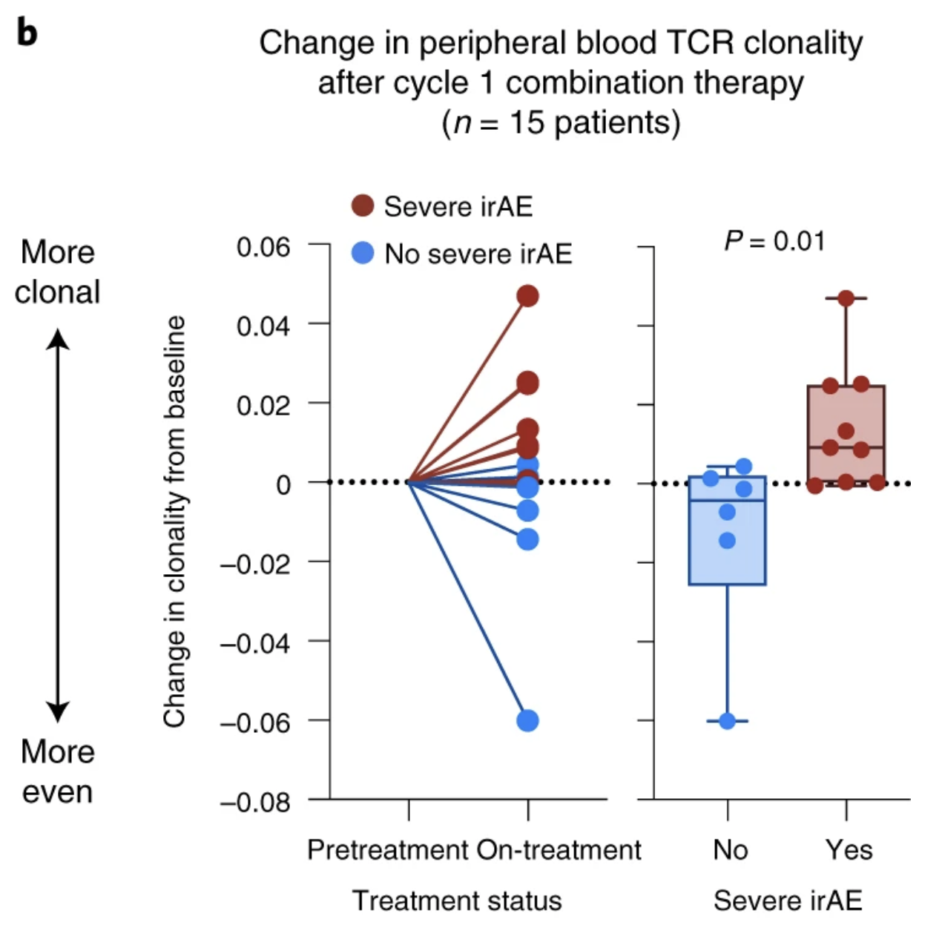
Main findings related to T cell clonal expansion
increased TCR clonal expansion and persistence of baseline clones in patients developing severe irAEs (preferential expansion of activated CD4 T_{EM})
Notes:
- prior evidence of clonally expanded self/virus-reactive T cells in affected tissue linking self/pathogen-recognizing T cell clones to irAEs (**I wonder why viral antigen recognition would lead to irAEs, good for the viral-infected cells to be attacked, right? but perhaps its an inappropriately strong immune response**)
c, Enrichment of a CD4 T 5 + 3 gene signature in CD4 T cells from pretreatment PBMC samples obtained from 3 patients analyzed in b, all of whom developed severe irAEs and showed TCR clonal expansion after ICI initiation (Extended Data Fig. 9d). The box center lines, box bounds and whiskers indicate the medians, first and third quartiles and minimum and maximum values, respectively. The points denote cells profiled by scRNA-seq and annotated either by Azimuth (CD4 naive, n = 245 cells; CD4 T_{CM}, n = 320 cells) or by their clonal persistence from baseline to early on-treatment time points (persistent CD4, n = 190 cells). The most persistent CD4 clonotypes in this analysis showed evidence of clonal expansion (Extended Data Fig. 9f,g). Significance was determined relative to persistent cells by a two-sided, unpaired Wilcoxon rank-sum test. ssGSEA, single-sample GSEA.

Slide 5
Limitations
Unanswered questions
Higher propensity for these activated CD4 T_{M} cells to recognize self antigens in patients at risk for severe irAEs?
Where are these CD4 TM cells localized, periphery?
Limitations
Retrospective
Different ICIs studied have different irAE risks
May have missed long to arise after ICI irAEs
Notes:
- unanswered question: do circulating activated CD4 TM cells (their abundance here found to correlate with irAE development) exhibit a higher propensity to recognize self-antigens in patients at risk for severe ICI induced irAEs?
- most irAEs occur within first 3 months but some can occur later (which would have been missed here, median time to severe irAE here was ~6 weeks with no irAEs after 3 months)

Slide 6
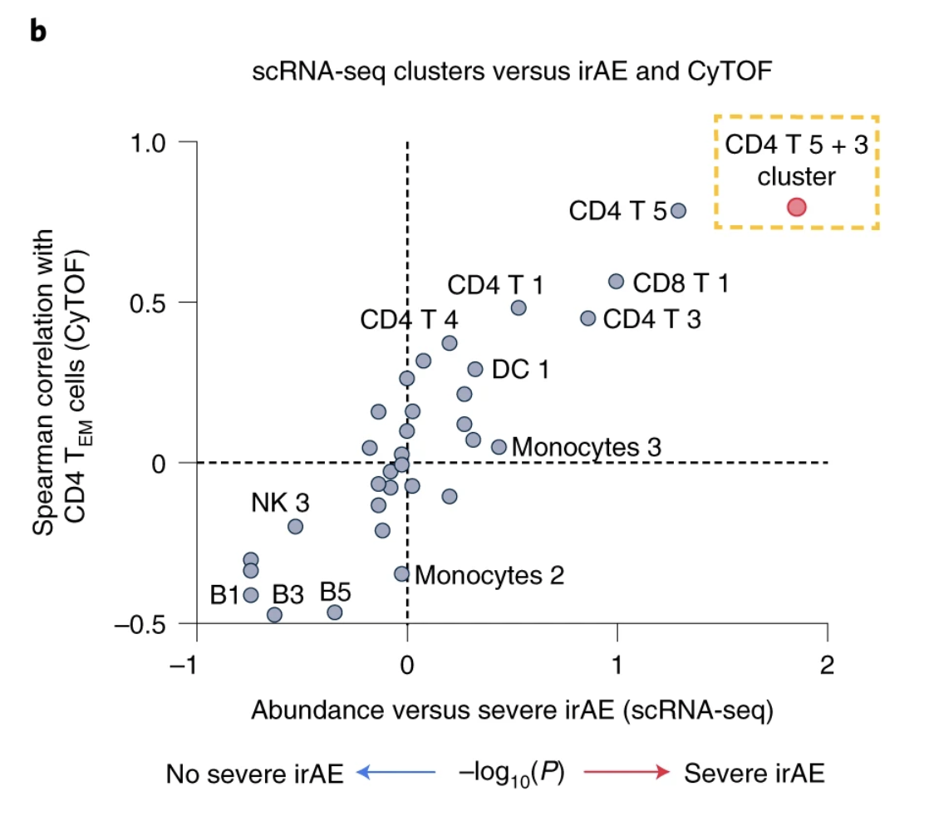
Struggled to extract subclusters of interest via this plot

Slide 7
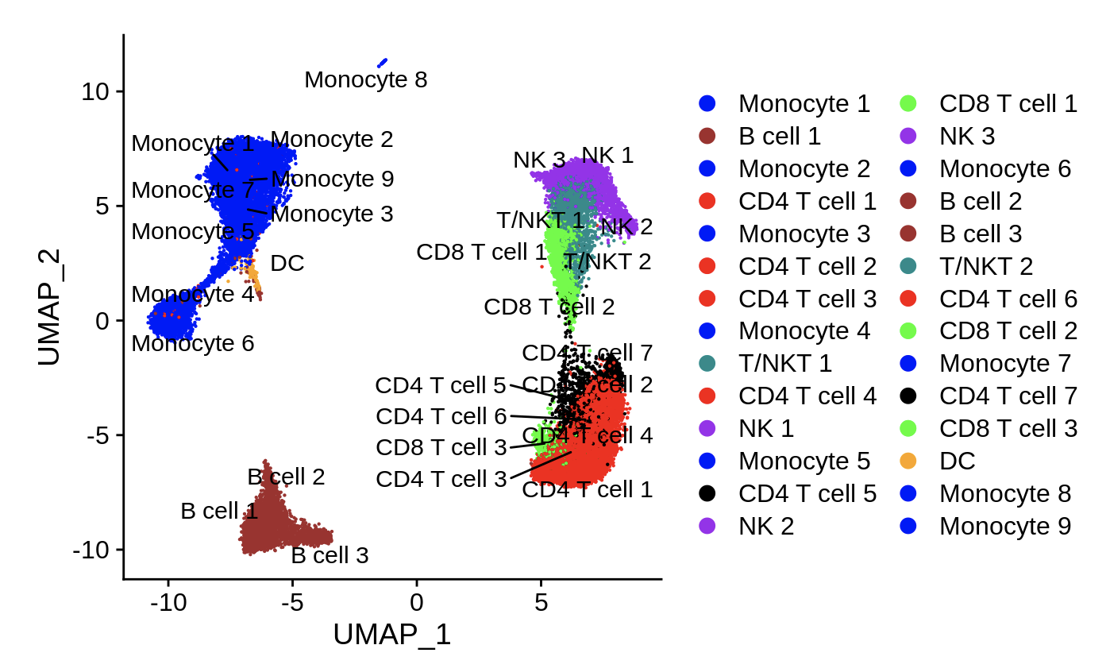
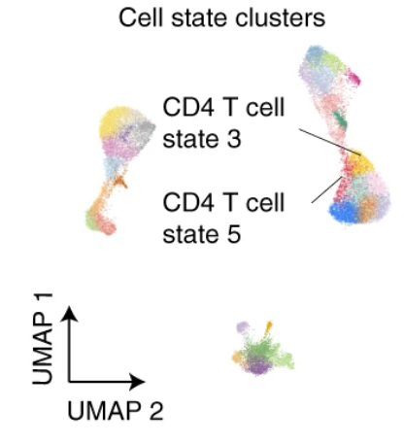
Instead compared UMAPs to find CD4 subclusters of interest
My analysis
Their analysis
Black color is what I call their CD4 T cell states 3 and
In my UMAP (states 5 and 7)

Slide 8
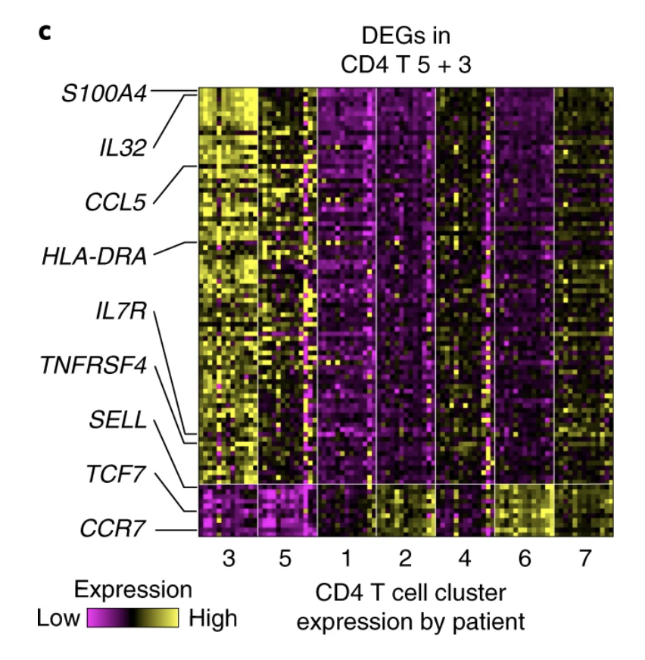
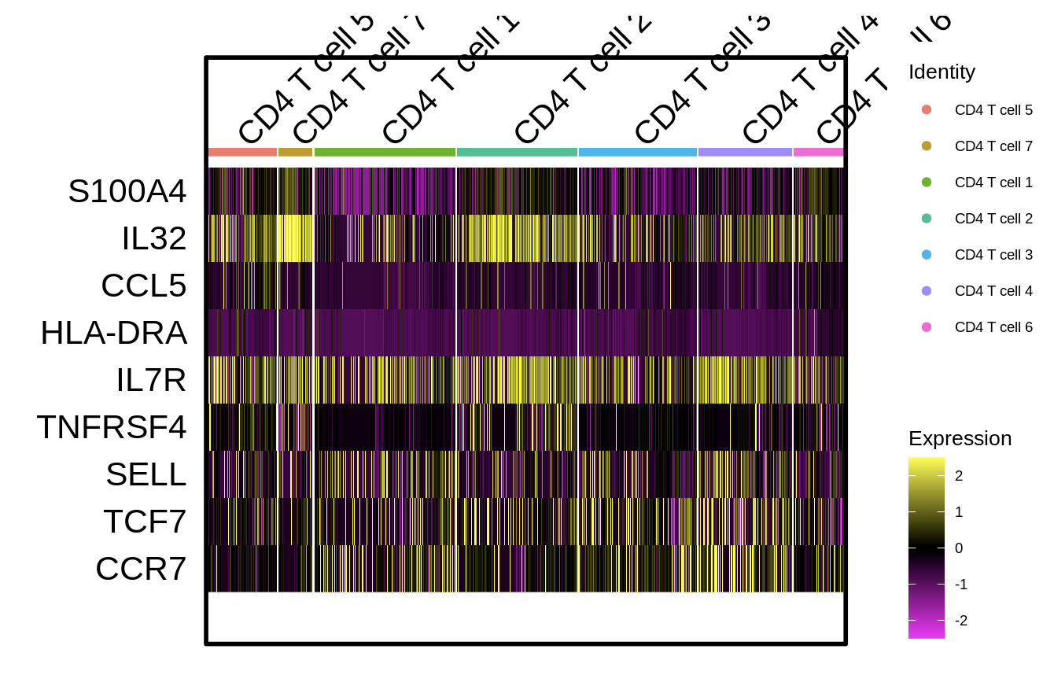
DEGs in CD4 T cell subclusters do not look very similar
My analysis
Their analysis

Slide 9
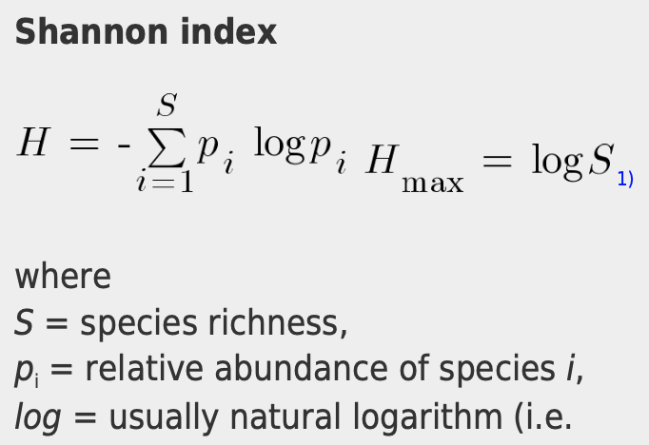
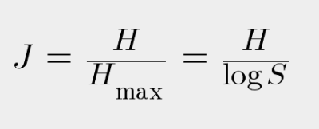
Methods: diversity and clonality indices
Shannon entropy
diversity score
considers richness and evenness
Complement of Pielou evenness
clonality
dominance/evenness of T cell clones in population
1 - Pielou evenness
Pielou evenness:
Notes:
Shannon entropy provides a comprehensive measure of diversity that considers both the variety of T-cell clones (richness) and their relative abundances (evenness), represents uncertainty with which we can predict which clonotype a randomly selected TCR is (if monoclonal, no uncertainty i.e. value of 0. if more polyclonal higher uncertainty but less so if not very even), puts more weight on richness than evenness
Richness measures the total number of unique T-cell clones, regardless of their abundances.
Clonality assesses the dominance or evenness of T-cell clones in a population
Pielou evenness: ratio of Shannon index and max Shannon for community with same richness (i.e. all species having same evenness), 1 means equal abundances. S here is TCR sequences (species)

Slide 10
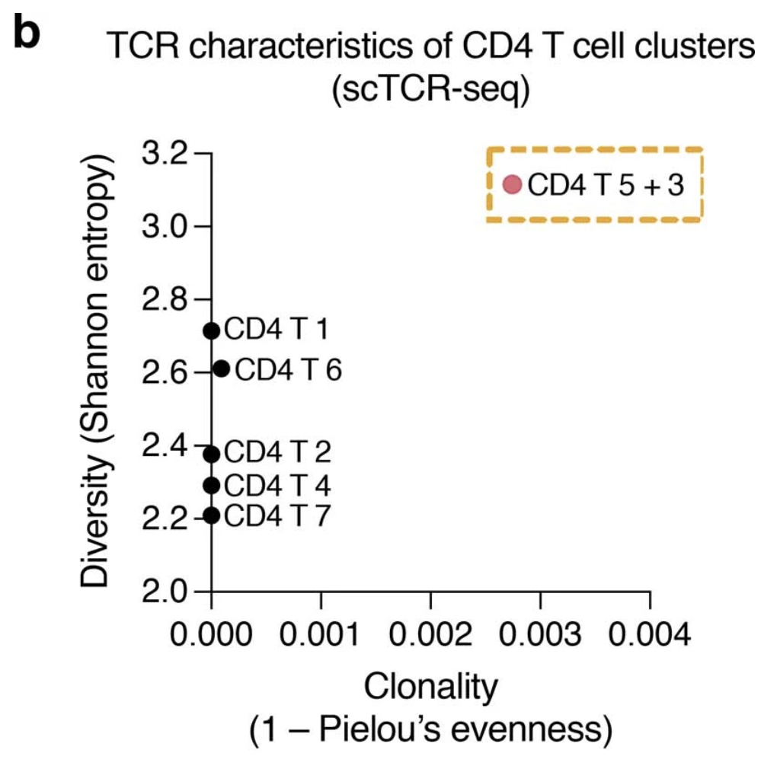
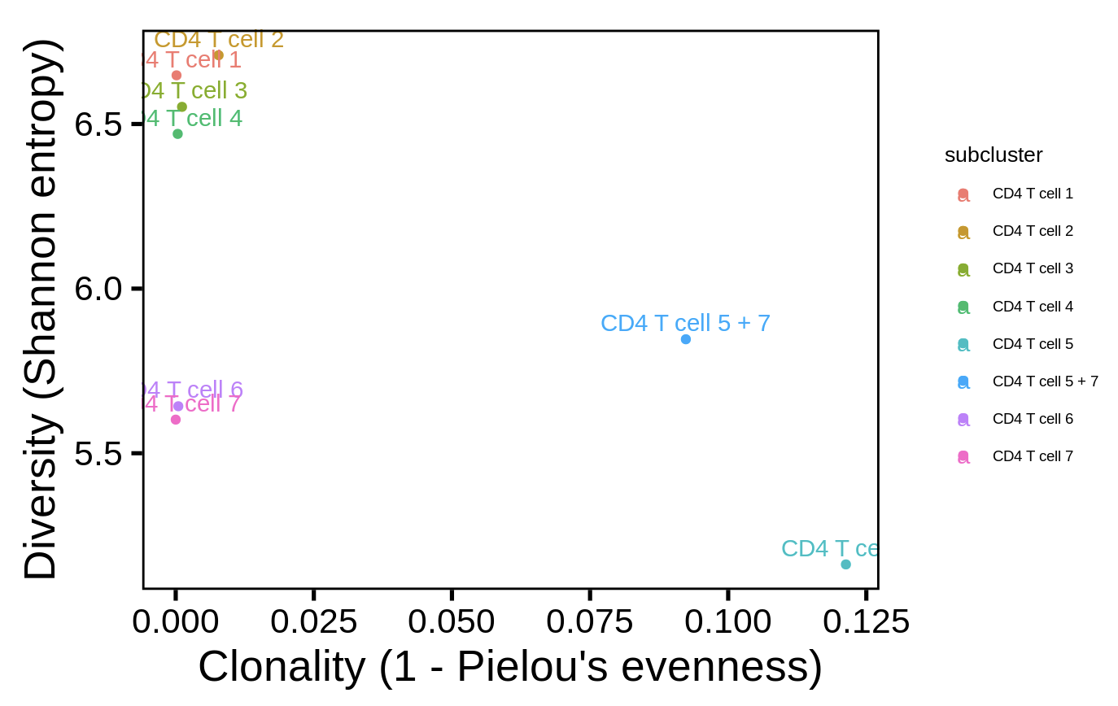
Same subclusters somewhat stand out in diversity vs. clonality plot
Their analysis
My analysis
Notes:
Shannon entropy provides a comprehensive measure of diversity that considers both the variety of T-cell clones and their relative abundances.
Richness measures the total number of unique T-cell clones, regardless of their abundances.
Clonality assesses the dominance or evenness of T-cell clones in a population.
Trying to wrap my head around what it means for subset to be high in both diversity and clonality (initially kind of seem mutually exclusive…)

Slide 11
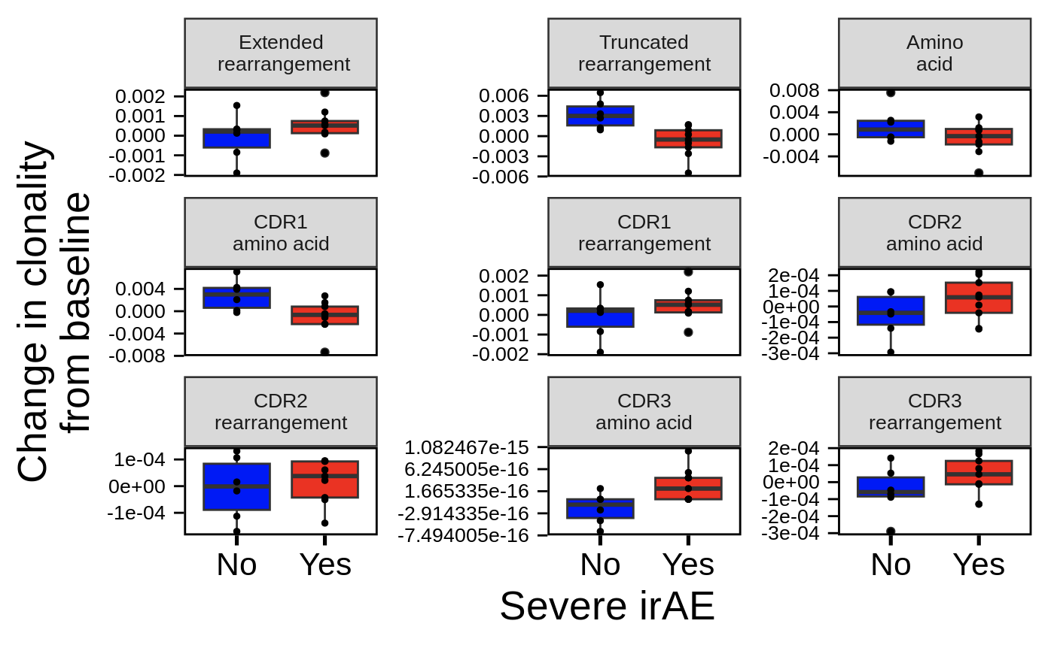
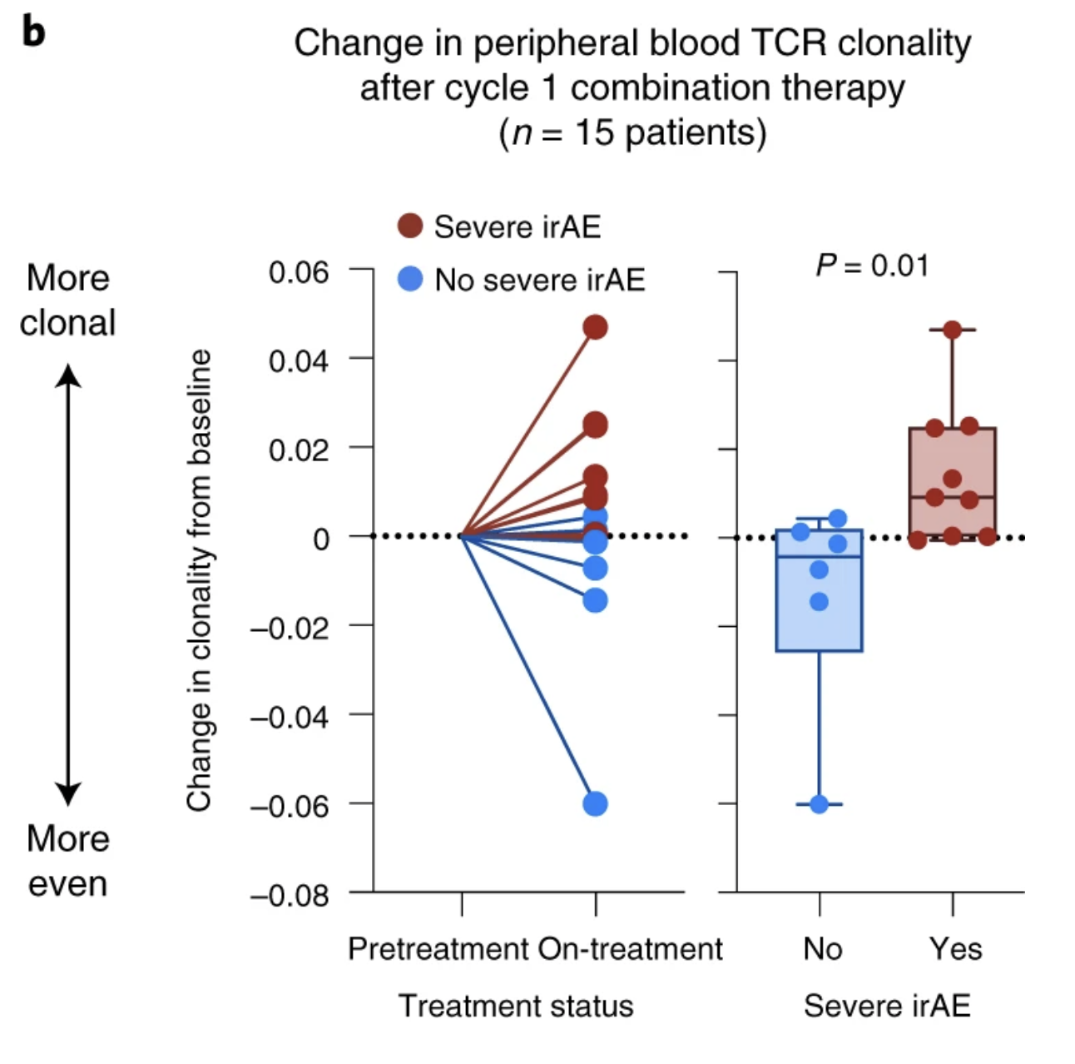
Change in TCR clonality analysis somewhat matches theirs
My analysis
Their analysis
Notes:
TCR clonality index that is robust to variation in the number of clones captured (Pielou’s evenness)
the complement of clonal evenness (1-Pielou’s index) is often used to get a clonality score of 0 representing a maximally diverse population with even frequencies and values close to 1, a repertoire driven by clonal dominance.
Shannon entropy provides a comprehensive measure of diversity that considers both the variety of T-cell clones and their relative abundances.
Richness measures the total number of unique T-cell clones, regardless of their abundances.
Clonality assesses the dominance or evenness of T-cell clones in a population.

Slide 12
Next steps
Explore unanalyzed data: analyze characteristics of expanded cells’ TCRs
Length
Germline-ness
Try these types of analyses on BRI dataset?
Notes:
Germline-ness: more germline-like is less random nt added to Cdr3 during development? Ask Peter for code

